Slide 1
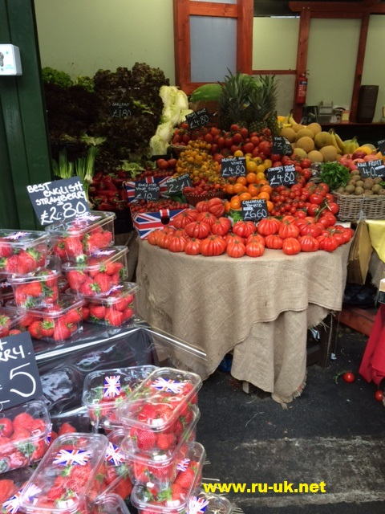
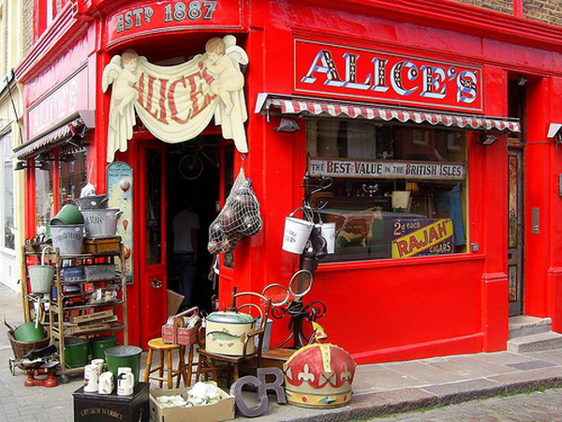
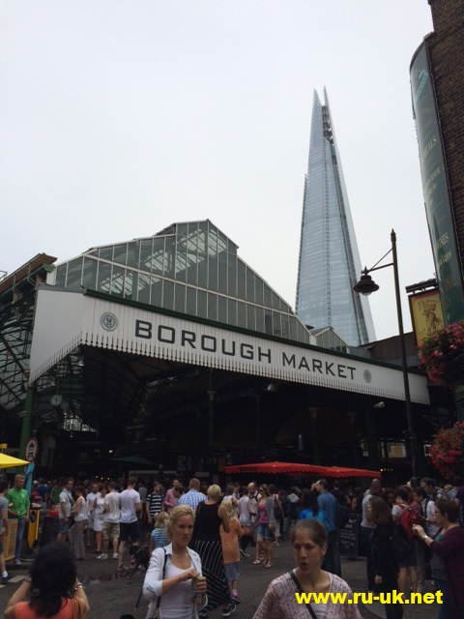
Let’s buy….

Slide 2
Match the words and phrases.
Expensive | Продавец
Cheap | Назначить завышенную цену
Overcharge | Дорогой
Purse | Быть стесненным в средствах
Vendor | Кошелек
To be on a tight budget | Дешевый

Slide 3
Online Shopping
Ten years ago most people didn’t even know what the Internet was. Today, the Internet is one of the most powerful tools throughout the world. The Internet is a collection of various services and resources. The Internet's main components are e-mail and the World Wide Web. The Internet helps us in different ways. We can read lots of interesting things (encyclopedias, poems or even books), we can send letters or even, what is very popular recently, we can do shopping without leaving our houses. As internet shopping is so popular nowadays we need to be aware of its advantages and disadvantages.
Many people fear internet shopping because of its disadvantages. They claim that the worst thing is that there is no guarantee of receiving the desired product. The seller can simply mail a pig in a poke and then the money is lost. They are right because that kind of things happen very often and we can’t do anything about it. So people should buy only from a reliable source. Another thing is that we have to pay for the delivery and it can be a really big price when the parcel is heavy or comes from overseas.

Slide 4
And what when the product is just not the thing we ordered? We have to send it back to the seller and pay for another post delivery. And what's about our health? People don't go shopping, don't walk but just sit in front of the screen. It affects not only our body but our eyes too. The effect is simple: more people wear glasses and internet shops sell more clothes in XXL size. Another disadvantage is that there is less employment for shop assistants, security men, etc. Maybe it isn’t very visible now but it will be in the future. Still in spite of the disadvantages internet shopping becomes more and more popular, people are interested in buying by means of virtual shops. People can find the desired product much faster than in the shops. An­other fine thing about internet shopping is that there is an enormous choice. Furthermore the products in the Internet are cheaper than in the shops. But going shopping with your family or friends is much more fun than sitting in front of the screen.

Slide 5
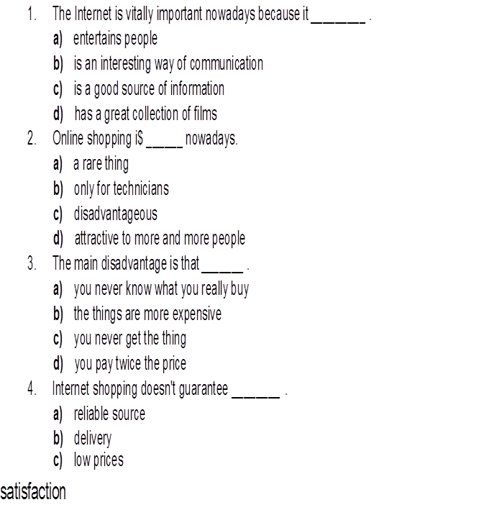
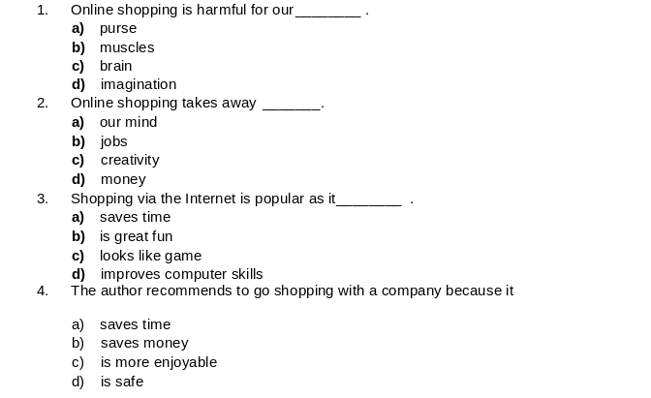
Choose the right options

Slide 6
I think – я думаю
o Then - затем
o Furthermore - более того
o Nevertheless – тем не менее
o Another thing is that -другое дело, что
o Moreover – более того

Slide 7
Advantages and Disadvantages of Shopping Online
Easier
looking
easily
to look
find
searching
paying
more
don’t have
don’t find
wasting
are forced
worse
don’t like
switch
cheaper

Slide 8
Hometask
p. 29 ex. 14.
You’ve got a letter from your friend. Write her/him a letter and answer her/his four questions. Write 100-120 words

Slide 9
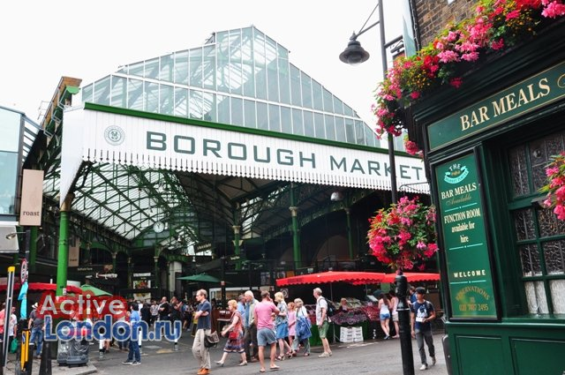
Thank you. Good-bye!

